Slide 1
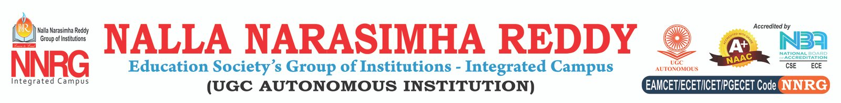


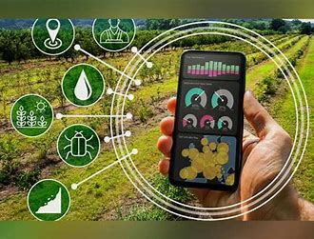
AI POWERED CROP DISEASE AND PESTS DETECTION
Presenter’s Name:
V.PHANINDRA(227Z1A66C7)
N.VARSHINI(227Z1A6693)
N.SAIAKHIL(227Z1A6694)

Slide 2
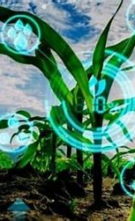
Problem Statement
Small farmers face significant challenges in identifying and managing crop diseases and pests due to limited access to expert advice and resources.
Conventional methods for pest and disease control often lack accuracy, personalization, and real-time updates, leading to reduced crop yields.
Many existing solutions are either too expensive, complex, or inaccessible to farmers with limited technical expertise.
The need for a seamless, AI-powered platform that delivers accurate, real-time, and easy-to-understand crop health insights remains unaddressed.

Slide 3
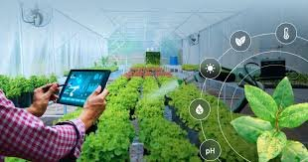
Solution Overview
Leverages advanced AI to analyze plant images, soil data, and weather patterns, identifying crop diseases and pests with high precision.
Provides personalized, actionable advice on pest and disease management using natural, organic, or conventional methods.
Offers accurate, up-to-date data insights for smarter decision-making, empowering farmers to act proactively.
Intuitive interface, voice assistant, and chatbot make the platform accessible and easy to use for farmers of all technical levels.

Slide 4
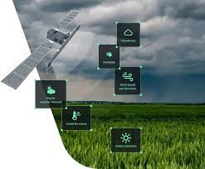
Key Features
AI-powered detection of crop diseases and pests.
Personalized pest and disease control methods.
Real-time data insights for smarter decisions.
Voice assistant and chatbot for easy interaction.
User-friendly interface for farmers of all skill levels.

Slide 5
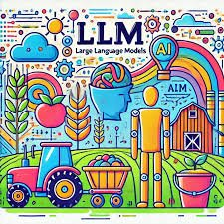
Technology Stack
Frontend: Vite, React, TypeScript
Backend: APIs, LLM integration
AI/ML: Advanced AI models for crop analysis
User Interaction: Voice assistant, chatbot
Data Handling: Real-time data integration for insights

Slide 6
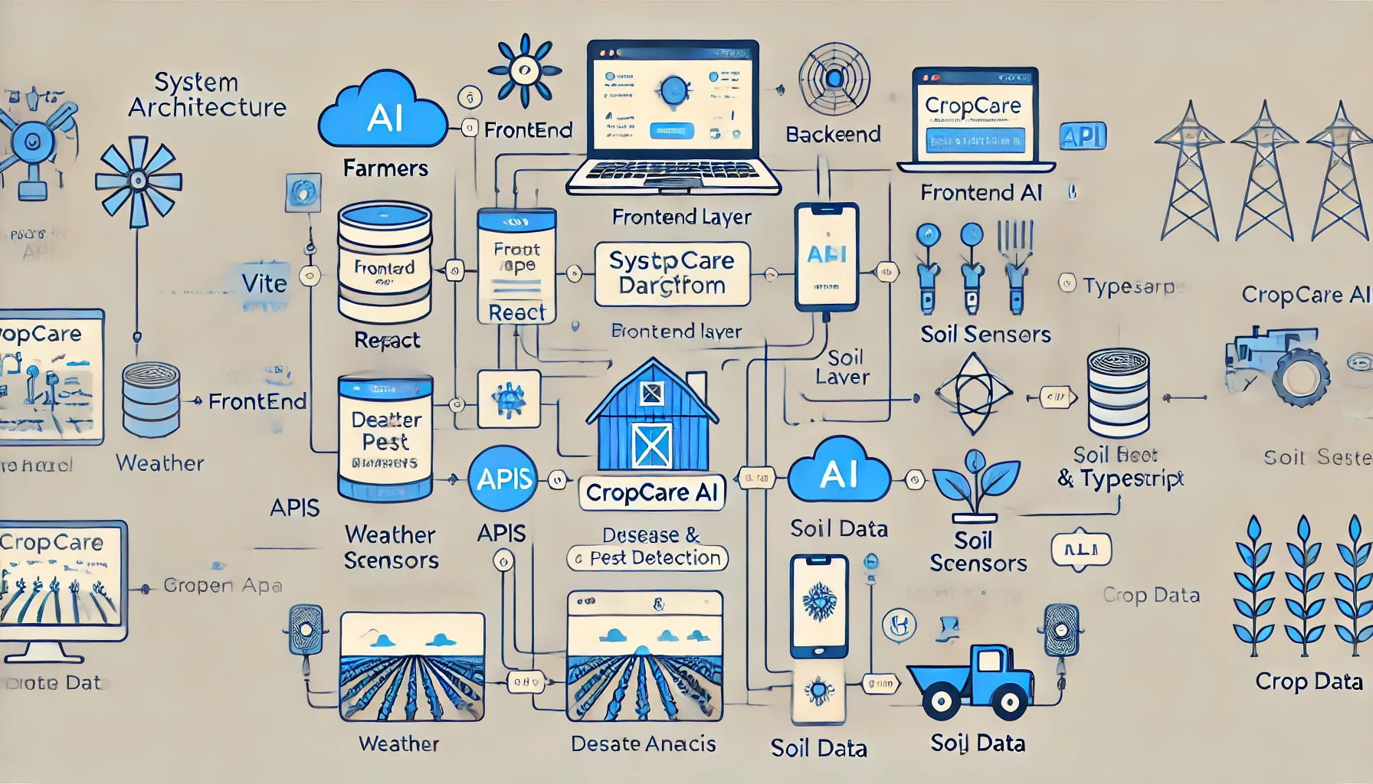
System Architecture

Slide 7
Benefits:
Early detection of crop diseases and pests.
Personalized and actionable farming solutions.
Improved crop yield through informed decision-making.
Accessible platform for farmers of all technical levels.
Time and cost savings with real-time insights.

Slide 8
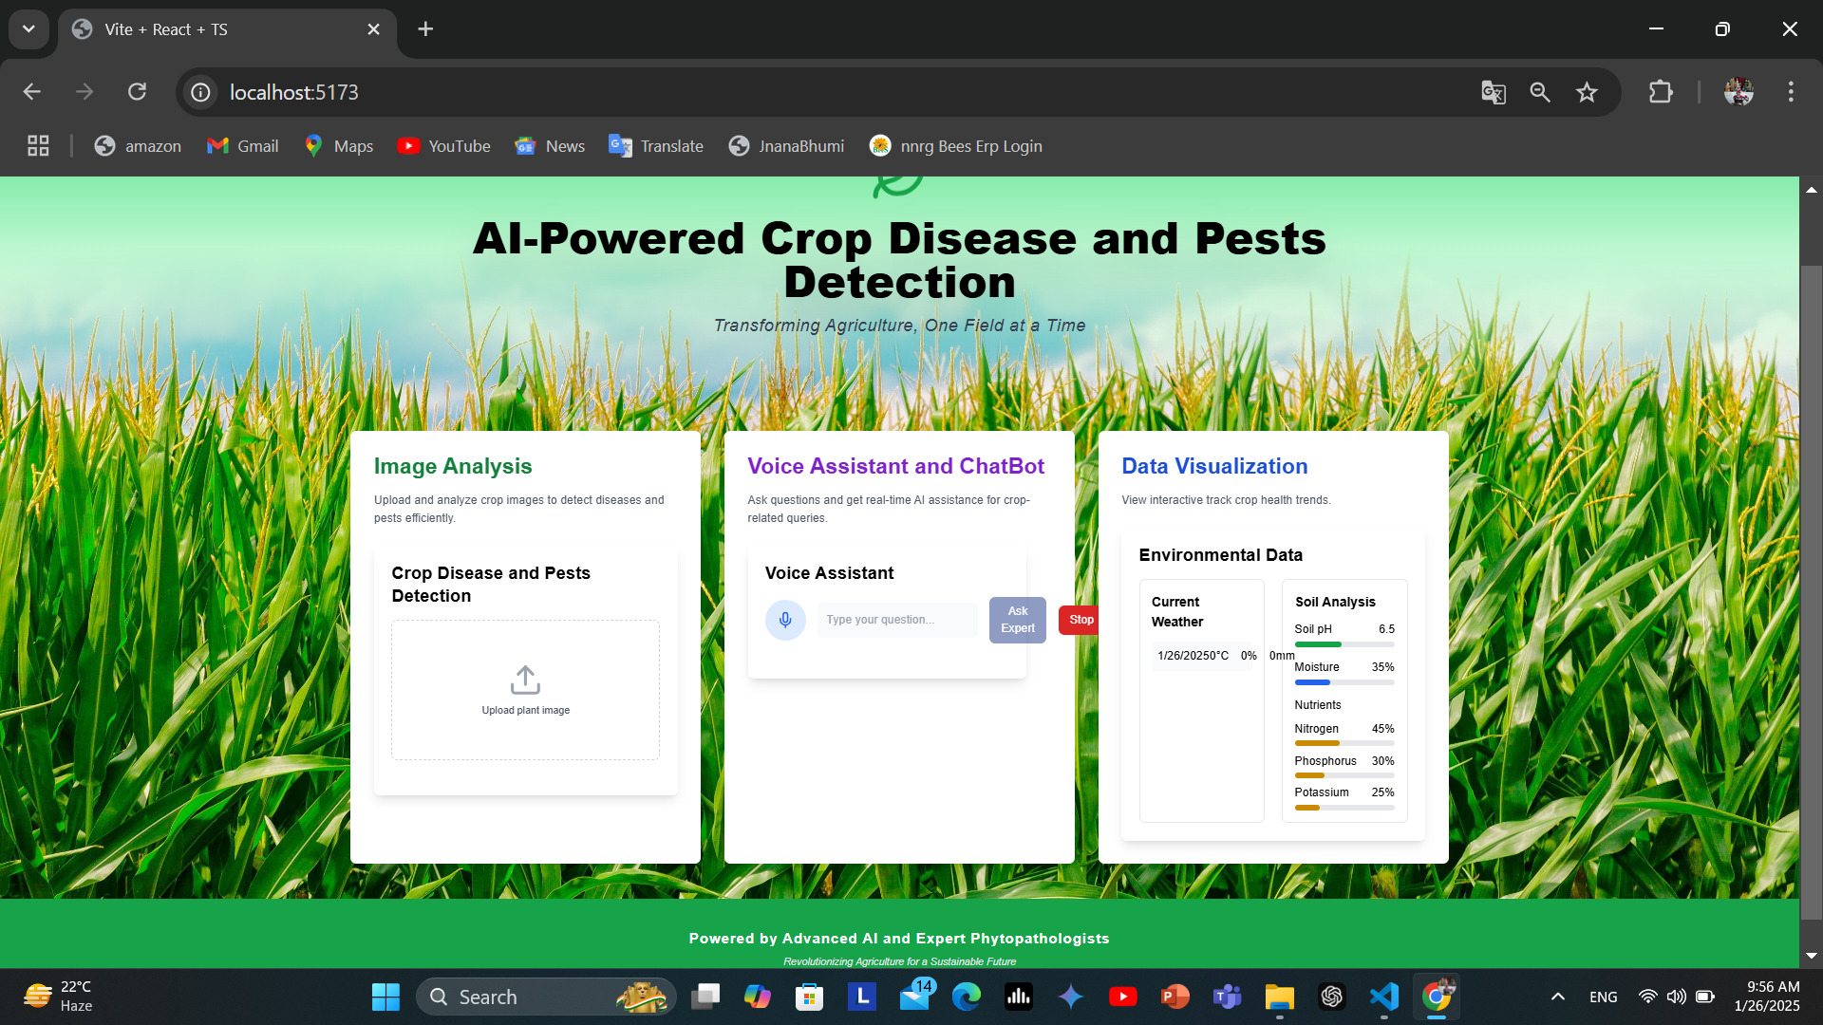
Monitoring Dashboard
Real-time crop health updates
Insights on weather and soil data
Pest and disease trend analysis
Chatbot and voice assistant integration
Customizable reports for farmers

Slide 9
AI Features :
AI Detection: Accurate identification of crop diseases and pests from images and data.
Control Methods: Real-time advice on pest control using tailored solutions.
Data Insights: Up-to-date information for informed decision-making.
Voice & Chatbot: Easy interaction through voice commands and chatbot assistance.

Slide 10
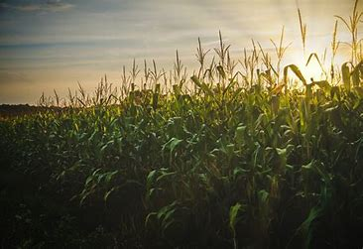
Impact:
Environmental sustainability
Resource conservation
Improved crop yields
Cost reduction
Scalable solution

Slide 11
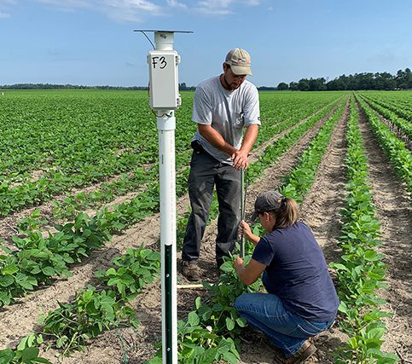
Future Enhancements
Advanced AI Models: Incorporate machine learning for improved disease prediction and pest behavior analysis.
Mobile Application: Develop a mobile app for on-the-go access to features and alerts.
Community Forum: Create a platform for farmers to share experiences and solutions.
Integration with IoT Devices: Connect with sensors for real-time monitoring of soil and environmental conditions.

Slide 12
Business Potential & Future Prospects
Scalable Model: The pole-based system can be implemented across different regions in India and beyond, benefiting small farmers.
Sustainability Focus: The system encourages sustainable farming practices, promoting organic and natural pest control methods.
Partnership Opportunities: Potential to collaborate with agricultural organizations, government bodies, and NGOs to enhance farmer outreach.
Subscription Model: A recurring revenue model through subscription services for data monitoring and expert advice.
Future Enhancements: Integration with drone technology for aerial monitoring, expansion to more crops, and predictive models for climate impacts.

Slide 13


